Slide 1

SIMPLE VOTING SYSTEM
Project Presentation

Slide 2
INTRODUCTION
The voting system is a console-based C application that simulates a basic election process.
It demonstrates how to:
Manage candidates dynamically using linked lists.
Track voters and their vote status using arrays.
Implement user input validation and menu-driven interaction.

Slide 3

OBJECTIVES
Design and build a functional voting system using C.
Learn how data structures like linked lists and arrays can model real-world scenarios.
Develop logic for checking eligibility and casting votes.
Display results, handle memory, and manage user interaction through menus.

Slide 4
SYSTEM REQUIREMENTS
Hardware Requirements:
CPU: Minimum 1 GHz
RAM: 512 MB or more (very lightweight application)
Storage: Less than 1 MB of disk usage
Input: Keyboard (console input)
Software Requirements:
Operating System: Windows / Linux / macOS
Compiler: GCC, Turbo C, Code::Blocks, or any standard C compiler
Text Editor: Code::Blocks, Visual Studio Code, or any IDE supporting C

Slide 5
DATA STRUCTURES USED
Linked List – Candidates
Used to store and display the list of candidates.
Each node holds:
Candidate ID
Candidate name
Pointer to the next candidate
2. Array – Voters
Fixed-size array of Voter structures.
Tracks : Voter ID
Whether the voter has already voted
3. Array – Vote Count
Array where each index corresponds to a candidate’s ID.
Tracks total votes received by each candidate.

Slide 6
KEY FUNCTIONS
addCandidate(id, name) – Adds a new candidate to the list.
registerVoters(count) – Initializes voters.
isVoterEligible(voterID) – Checks voter status.
vote(voterID, candidateID) – Casts a vote.
displayCandidates() – Shows all candidates.
displayResults() – Shows vote counts.
displayWinner() – Announces winner.
displayVoterStatus() – Lists voters' participation

Slide 7
WORK FLOW
Step 1: Start the program and input the number of candidates and their names.
Step 2: Register all candidates using a linked list structure.
Step 3: Input the number of voters and initialize voter records.
Step 4: Display a menu and take user input for desired operation.
Step 5: Perform actions like casting votes, showing results, or checking voter status.
Step 6: On exit, free memory and terminate the program

Slide 8
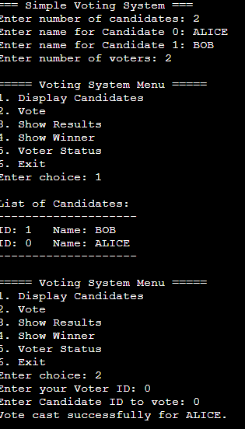
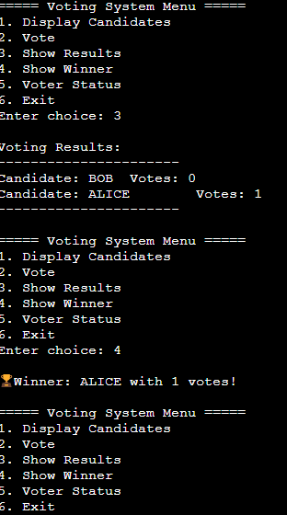
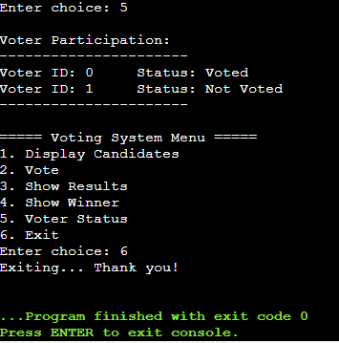
OUTPUT

Slide 9
ADVANTAGES
Efficient Data Structures:
Uses linked lists for dynamic candidate management and arrays for voters and vote counts.
User-friendly Interface:
Simple, menu-driven system for easy interaction and navigation.
Ensures Voting Integrity:
Prevents multiple voting by the same voter and validates eligibility.
Real-time Results:
Displays immediate vote tally and determines the winner automatically.
Memory Management:
Dynamically allocates and frees memory, preventing memory leaks

Slide 10
CONCLUSION
This project demonstrated a practical example of:
Implementing real-world logic in C
Using data structures to manage dynamic and fixed-size data
Understanding user interaction and control flow in command- line programs

Slide 11
THANK YOU

